Slide 1
instrustion detection of Imbalanced Network Traffic Based on Machine Learning

Slide 2
ABSTRACT
Cyber attack detection can identify unknown attacks from network traffics and has been an effective means of network security.
Nowadays, existing methods for network anomaly detection are usually based on traditional machine learning models, such as KNN, SVM, etc.
Although these methods can obtain some outstanding features, they get a relatively low accuracy and rely heavily on manual design of traffic features
To solve the problems of low accuracy and feature engineering in intrusion detection, a traffic anomaly detection model is proposed. The cyber attack detection model uses Multi Layer Perception and Logistic regression classifier algorithms for better efficiency in prediction.

Slide 3
PROPOSAL
We propose an end-to-end Machine Learning based cyber attack detection method that is composed of Logestic Regression and other Machine Learning Algorithms. Logistic Regression can well solve the problem of intrusion detection and provide a new research method for intrusion detection.
We train model using linear regression model and predict packet is malicious or not based on user input.
We evaluate our proposed network with a real NSL-KDD dataset.
We compare accuracy of multiple machine learning models and find accuracy of each model. In proposed system along with Logistic Regression MLP multi layer perception method is used to train dataset.

Slide 4
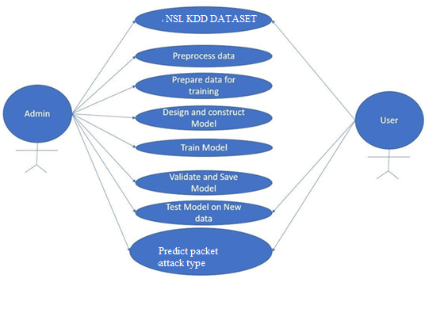
DESIGN FLOW- Use Case Diagram

Slide 5
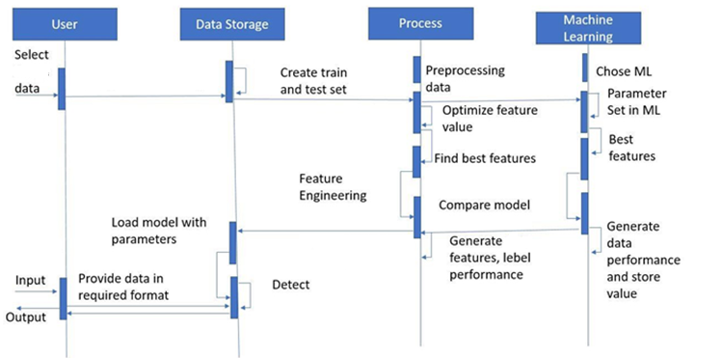
SEQUENCE DIAGRAMS

Slide 6
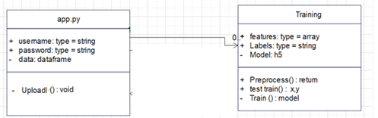
Class Diagram

Slide 7
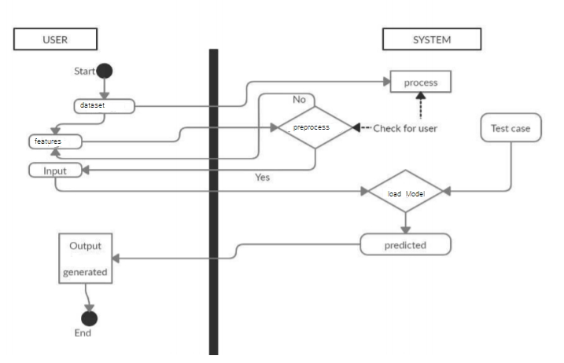
Activity Diagram

Slide 8
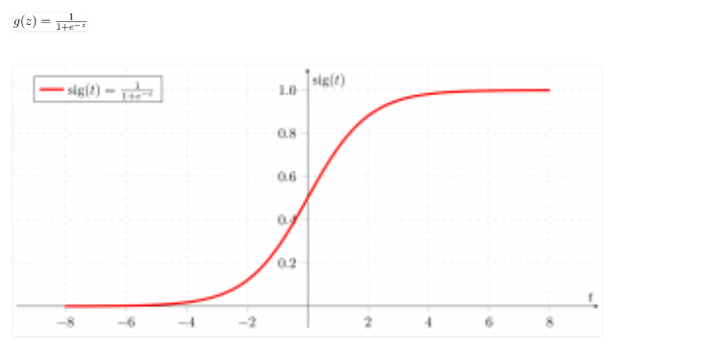
ALGORITHM
Logistic regression is basically a supervised classification algorithm. In a classification problem, the target variable(or output), y, can take only discrete values for a given set of features(or inputs), X. Contrary to popular belief, logistic regression IS a regression model. The model builds a regression model to predict the probability that a given data entry belongs to the category numbered as “1”. Just like Linear regression assumes that the data follows a linear function, Logistic regression models the data using the sigmoid function.

Slide 9
Logistic regression becomes a classification technique only when a decision threshold is brought into the picture. The setting of the threshold value is a very important aspect of Logistic regression and is dependent on the classification problem itself. The decision for the value of the threshold value is majorly affected by the values of precision and recall. Ideally, we want both precision and recall to be 1, but this seldom is the case.
binomial: target variable can have only 2 possible types: “0” or “1” which may represent “win” vs “loss”, “pass” vs “fail”, “dead” vs “alive”, etc.
multinomial: target variable can have 3 or more possible types which are not ordered(i.e. types have no quantitative significance) like “disease A” vs “disease B” vs “disease C”.
ordinal: it deals with target variables with ordered categories. For example, a test score can be categorized as:“very poor”, “poor”, “good”, “very good”. Here, each category can be given a score like 0, 1, 2, 3.
First of all, we explore the simplest form of Logistic Regression, i.e Binomial Logistic Regression.

Slide 10
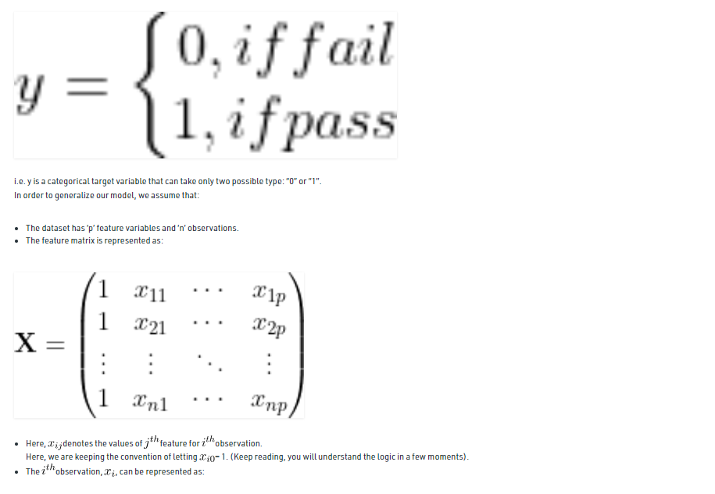

Slide 11
